Slide 1
Minor Project on
Review Rating Prediction using Ensemble Learning
Group : 40
Nipun (Roll: 1906135)
Roshan Pandey(Roll: 1906138)
Sandeep Kumar(Roll: 1906145)
Under the Supervision of : Dr Mukesh Kumar (Assistant Professor) Dept. of CSE, NIT Patna
April 29, 2022
Minor Project
April 29, 20221 / 27

Slide 2
Outline
Introduction Motivation Literature survey Proposed Method
Results Analysis and Discussion Conclusion and Feature Work Refrences
Minor Project
April 29, 20222 / 27

Slide 3
Introduction
Hotel businesses are becoming increasingly popular nowadays and hotel reviews have become an important parameter for hotel evaluation. Hotel Ratings play an important role for judging the hotels for any individual.
It influences the user decision and signifies the credibility of the hotel. The hotel rating can depend on various factors like reviews, location, average cost of a person, cuisines and many other factors.
Hotel Ratings play an important role for judging the hotels for any individual. It influences the user decision and signifies the credibility of the hotel.
Minor Project
April 29, 20223 / 27

Slide 4
Motivation
It has been observed that the user may forget to provide the rating for the hotel but provided the review for the same. This leads to another challenge to predict the rating based on the review provided y the customer
Since Every customer may have different level of knowledge to speak and write the languages and it may impact the understanding of the reviews as well. These challenges of natural language requires a method to understand each and every review provided by the different customers.
Minor Project
April 29, 20224 / 27

Slide 5
Literature Survey
R.N. | Author | Task | Feild | Classifier | Result
[1] | Krishna | Sentiment Analy- sis of Restaurant Reviews | Resturant | SVM | Accuracy- 94.56%
[2] | Zahoor | Sentiment Analy- sis and Classifica- tion of Restaurant Reviews | Resturant | Random Forest | Accuracy- 95%
[3] | Asghar | Review Rating Prediction | Bussiness Prod- ucts and Reviews | Logistic Regres- sion | Accuracy- 64%
Table 1:Rating Predicition System literature survey
Minor Project
April 29, 20225 / 27

Slide 6
Literature Survey contd.
R.N. | Author | Task | Feild | Classifier | Result
[4] | Rafay | Robust Review Rating Prediction Model based on Machine and Deep Learning: Yelp Dataset | Bussiness Restu- rant Reviews | Convolut ion Long Short Term Memory (CLSTM). | Accuracy- 90.1%
[5] | Govindarajan, | SENTIMENT | Resturant | Proposed | Accuracy-
 | M | ANALYSIS OF | Reviews | Hybrid | 92.44%
 |  | RESTAURANT |  | Method
 |  | REVIEWS US-
 |  | ING HYBRID
 |  | CLASSIFICATION
 |  | METHOD
Table 2:Rating Predicition System literature survey
Minor Project
April 29, 20226 / 27

Slide 7
Literature Survey contd.
R.N. | Author | Task | Feild | Classifier | Result
[6] | Sadiq | Discrepancy detec- tion between ac- tual user reviews and numeric rat- ings of Google App store using deep learning | Google App , checking false | CNN | Accuracy- 89%
[7] | Luo | Predicting the Helpfulness of Online Restaurant Reviews Using Different Machine Learning Algo- rithms: | Resturant Reviews | SVM | Accuracy- 79.59%
(NIT Patna)
Table 3:Rat
ing Predicition System litera
t
ure survey
Minor Project
April 29, 20227 / 27

Slide 8
Literature Survey contd.
R.N. | Author | Task | Feild | Classifier | Result
[8] | Doan | Sentiment Analy- sis of Restaurant Reviews on Yelp with Incremental Learning | Resturant Reviews | Factori zation Machine | Accuracy- 96%
[9] | Tripathy, | Classification of Sentimental Reviews Using Machine Learning Techniques | Hotel Reviews | SVM | Accuracy- 94.06%
[10] | AL-Bakri, | Multi label restau- rant classification using support vec- tor machine | Hotel Reviews | SVM | Accuracy- 88%
Table 4:TLS literature survey
Minor Project
April 29, 20228 / 27

Slide 9
Data Set and Feature Selection
We obtained our data from HotelRec, a novel large-scale hotel recommendation dataset based on hotel reviews from TripAdvisor, and containing approximately 50 million reviews.
Properties in the Data Set:
Hotel url: the url of the given hotel;
Author: the author id who had given the rating and review for the following hotel.
Date: interaction given on the given date
Rating : rating of the interaction.
Title: describing the review in very short
Review : review given by customer.
Property dict: it will contain all the sub ratings like cleanliness, location, value
Minor Project
April 29, 20229 / 27

Slide 10
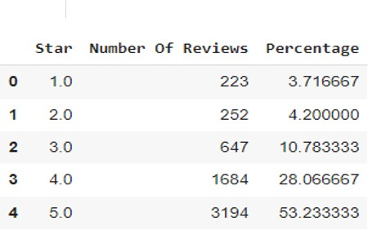
Dataset
This dataset supplies a good material for academic and research projects.Ideas and methods from machine learning, deep learning, and natural language processing (NLP) can be built and tested on this dataset.
Figure 1:Rating Statistics
Minor Project

Slide 11
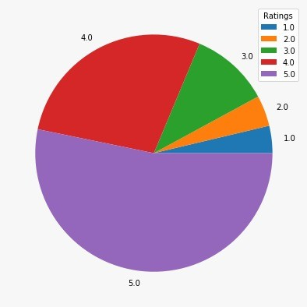
Dataset Statistics
The 6 presents the data distribution among different ratings of the dataset.
Figure 2:Dataset distribution among different ratings.
Minor Project

Slide 12
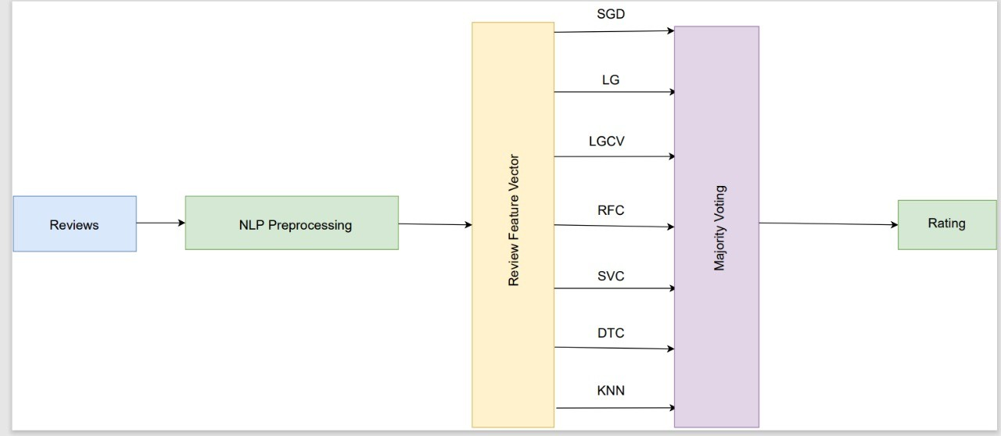
Proposed method
The whole architecture of project
Figure 3:Proposed architecture to predict the ratings.
Minor Project

Slide 13
Proposed method (contd.)
NLP preprocessing steps: Removing HTML tags. Expanding Contractions Removing STOP words. Conversion to base Words. Stemming
Lemmatization
Minor Project

Slide 14
Proposed method (contd.)
Bag of Words(BoW)
TF-IDF
Word Embedding - Word2Vec
Minor Project

Slide 15
Proposed method (contd.)
Bag of words
BoW is used to pre-process the text by converting it into bag of words , which keeps count of total occurrences of most frequent of words. The model can be visualized using the table , which containing count of words corresponding to word itself .
Count Vectroizer, from count vectorizer we get a matrix where each column represents the distinct words where each row corresponds document.
Minor Project

Slide 16
Proposed method (contd.)
Term Frequency - Inverse Document Frequency (TF-IDF)
Term Frequency
tf (t, d ) = (count of t in d / number of words in d) t is particular word
d is document
Inverse Document Frequency Idf =log(Dn/Dnw) where, Dn=Number of documents.
Dnw=Number of documents containing the word . tf-Idf(t, d) = tf(t, d) * Idf(t)
Minor Project

Slide 17
Proposed method (contd.)
Word Embedding : Word2Vec
Word2Vec , a word embedding technology enables similar words to have similar dimensions and consequently helps bring context. So now we got it
, we need to see also the context of the word and for that we need Word2Vec.
Minor Project

Slide 18
Proposed method (contd.)
The majority voting of the following classifiers has been used as the Ensemble learning technique.
SGD
Logistic Regression
Logistic RegressionCV
Linear SVC
Random Forest Classifier Decision Tree Classifier
K Nearest Neighbours (KNN)
Minor Project

Slide 19
Result Analysis and Discussion
The Evaluation Metrics are Precision(P) =tp/(tp + fp)
where, tp is the number of true positives and fp the number of false positives.
Recall(R)=tp/(tp + fn)
where, tp is the number of true positives and fn the number of false negatives
F1 score=2(P ∗ R)/(P + R)
Accuracy=
TP+TN TP+TN+FP+FN
Minor Project

Slide 20
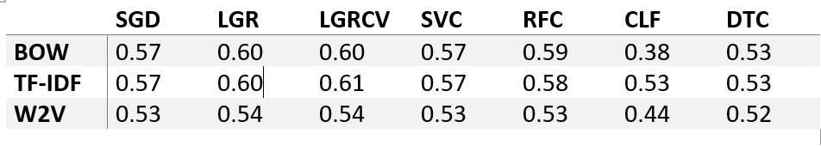
Result Analysis and Discussion
Figure 4:Comparison of Models
Minor Project

Slide 21
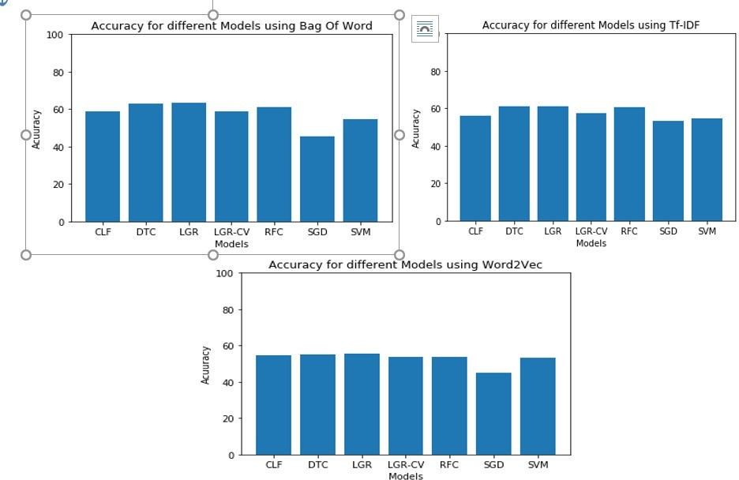
Result Analysis and Discussion
Figure 5:Comparison by bar graphs of different models
Minor Project

Slide 22
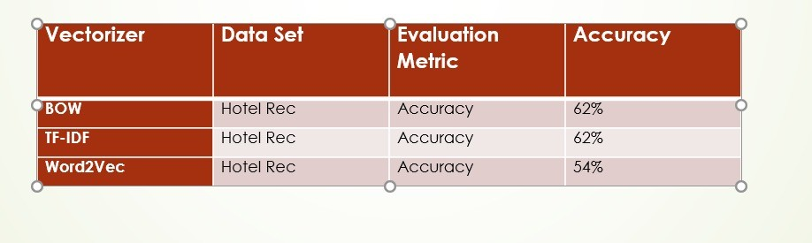
Result Analysis and Discussion
Figure 6:Result of Majority Voting on all Vectorizers
Minor Project

Slide 23
Conclusion
The proposed work has developed an Ensemble-Learning based method to predict ratings based on the hotel reviews provided by the customers.
We have predicted Rating for reviews on HotelRec Dataset. We applied 7 Machine Learning Models ::
SGDClassifier, LogisticRegression ,LogisticRegressionCV, LinearSVC, RandomForestClassifier , KNeighborsClassifier and DecisionTreeClassifier.
We did a comparison between the models and achieved maximum accuracy of 61% for TF-IDF using the Logistic Regression Cross Validation.
Minor Project

Slide 24
Future work
Deep Learning models can be applied on the data set.
The rating prediction can be used to recommend the hotels to any customer. For each customer using the ‘author’ feature, we can keep track of the hotels reviewed by the author and out of the remaining hotels, we can recommend the top hotels to the author based on the personal history of the author using Collaborative and Content-based Filtering.
Minor Project

Slide 25
ReferencesI
Yucel, A., Caglar, M., Dolatsara, H.A., George, B. and Dag, A., 2021. Predicting hotel reviews from sentiment: a multinomial classification framework. Journal of Modelling in Management.
Shi, H.X. and Li, X.J., 2011, July. A sentiment analysis model for hotel reviews based on supervised learning. In 2011 International Conference on Machine Learning and Cybernetics (Vol. 3, pp. 950-954). IEEE.
Sodanil, M., 2016. Multi-language sentiment analysis for hotel reviews. In MATEC Web of Conferences (Vol. 75, p. 03002). EDP Sciences.
Marovi´c, M., Mihokovi´c, M., Mikˇsa, M., Pribil, S. and Tus, A., 2011, May.
Automatic movie ratings prediction using machine learning. In 2011 Proceedings of the 34th International Convention MIPRO (pp. 1640-1645). IEEE.
Wu, H.C., Hu, Y.H. and Huang, Y.H., 2014. Two-stage credit rating prediction using machine learning techniques. Kybernetes.
Yu, D., Mu, Y. and Jin, Y., 2017. Rating prediction using review texts with underlying sentiments. Information Processing Letters, 117, pp.10-18.
Minor Project

Slide 26
ReferencesII
[7]S. Wu, J., Zhang, Z. and Zhou, S.X., 2021. Credit Rating Prediction Through Supply Chains: A Machine Learning Approach. Production and Operations Management.
[8]Li, J.P., Mirza, N., Rahat, B. and Xiong, D., 2020. Machine learning and credit ratings prediction in the age of fourth industrial revolution. Technological Forecasting and Social Change, 161, p.120309.
Minor Project

Slide 27
The End
Minor Project

